Slide 1
Parental Fluids Therapy
Fluids and electrolytes disturbances

Slide 2
Indication of Parental fluid therapy
To provide water and electrolytes and nutrients to meet daily requirement
To replace water and correct electrolytes deficit
To administer medications and blood products

Slide 3
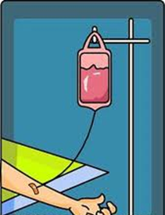
IV solutions contain dextrose or electrolytes mixed in various proportions with water

Slide 4
Types of IV solutions
Isotonic solution
Hypotonic solution
Hypertonic solution

Slide 5
Isotonic solution
A solution that has the same salt concentration as the normal cells of the body and the blood.
Examples:
1- 0.9% NaCl .
2- Ringer Lactate .
3- Blood Component .
4- D5W.

Slide 6
Hypotonic solution
A solution with a lower salts concentration than in normal cells of the body and the blood.
EXamples:
1-0.45% NaCl .
2- 0.33% NaCl .

Slide 7
Hypertonic solution
A solution with a higher salts concentration than in normal cells of the body and the blood.
Examples:
1- D5W in normal
Saline solution .
2-D5W in half normal
Saline .
3- D10W.

Slide 8
Categories of intravenous solutions according to their purpose
Nutrient solutions.
Electrolyte solutions.
Volume expanders.

Slide 9
Nutrient solution
It contain some form of carbohydrate and water.
Water is supplied for fluid requirements and carbohydrate for calories and energy.
They are useful in preventing dehydration and ketosis but do not provide sufficient calories to promote wound healing, weight gain, or normal growth of children.
Common nutrient solutions are D5W and dextrose in half-strength saline

Slide 10
Electrolyte solutions (Crystalloid)
fluids that consist of water and dissolved crystals, such as salts.
Used as maintenance fluids to correct body fluids and electrolyte deficit .
Commonly used solutions are:
-Normal saline
(0.9% sodium chloride solution).
-Ringer’s solutions
(which contain sodium, chloride, potassium, and calcium.
-Lactated Ringer’s solutions
(which contain sodium, chloride, potassium ,calcium and lactate) .

Slide 11
Volume expanders (Colloid)
Are used to increase the blood volume following severe loss of blood (haemorrhage) or loss of plasma ( severe burns).
Expanders present in dextran, plasma, and albumin.

Slide 12
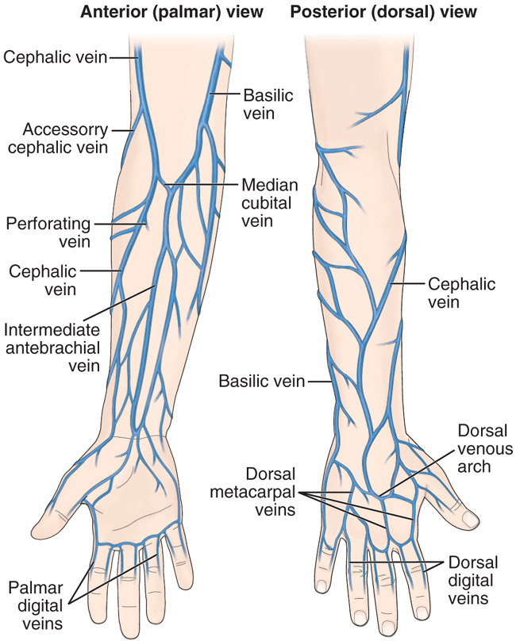
Administering IV Fluids
Choosing IV Site
Peripheral veins:
Arm veins are most
commonly used
Central veins:
Subclavian and
jugular veins

Slide 13
Consideration during selecting venipuncture site
Condition of the vein
Type of fluids or medication to be infused
Duration of therapy
Patients’ age and size
Weather the patient is right or left handed
Patients medical history and current health status
Skill of the person performing the venipuncture

Slide 14
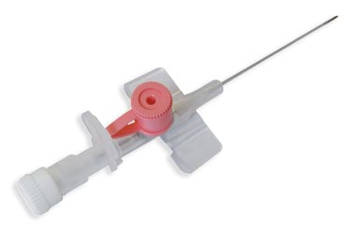
Equipment of parenteral therapy
Cannulas: length: ¾ to 1.25 inches, 20-22 Gauge; larger gauge for viscous solution, 14-18 for blood administration and trauma patients

Slide 15
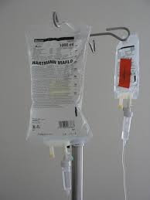
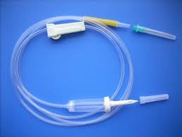
Solution bag or container
IV set

Slide 16
Nursing management of the patient receiving IV Therapy
Selecting the appropriate venipuncture site, type of cannulas and technique of vein entry:
Cleanse infusion site.
2- Excessive hair at selected site should be clipped with scissor .
3- Cleanse I.V site with effective topical antiseptic.
4- Made Venipuncture at a 10 to 30 degree angle

Slide 17
Nursing management: continue
Patient teaching :venipuncture, length of infusion, activity restriction
Preparing the IV site
Assess the solution: sterile, clear, no small particles, no leakage, not expired
Preparing and reading the lable on the solution
Determine the compatibility of all fluid and additives

Slide 18
Observe IV set for crack, hole, missing clamp, expired date
Assess any allergies and arm placement preference.
Assess any planned surgeries.
Assess patient’s activities of daily living.
Assess type and duration of I.V therapy, amount, and rate.

Slide 19
Nursing diagnosis
Anxiety (mild, moderate, severe) related to threat regarding therapy.
Fluid volume excess.
Fluid volume deficit.
Risk for infection.
Risk for sleep pattern disturbance.
Knowledge deficit related to
I.V therapy.

Slide 20
Planning
Identify expected outcomes which focus on:
preventing complications from I.V therapy.
minimal discomfort to the patient.
restoration of normal fluid and electrolyte balance .
patient’s ability to verbalize complications.

Slide 21

Implementation
I. Implementation during initiation phase
A) Solution preparation: the nurse should be:
Label the I.V container.
Avoid the use of felt-tip pens or permanent markers on plastic bag.
Hang I.V bag or bottle .

Slide 22
B-Regulating flow rate
The nurse calculate the infusion rate by using the following formula :
Gtt/mlof infusion set/60(min in hr)× total hourly vol= gtt /min

Slide 23
II. Implementation during maintenance phase
A) Monitoring I.V infusion therapy: the nurse should :
inspect the tubing.
inspect the I.V set at routine
intervals at least daily.
Monitor vital signs .
recount the flow rate after 5 and
15 minutes after initiation

Slide 24
B) Intermittent flushing of I.V lines
Peripheral intermittent are usually flushed with saline (2-3 ml 0.9% NS.)
C) Replacing equipments (I.V container, I.V set, I.V dressing):
I.V container should be changed when it is empty.
I.V set should be changed every 24 hours.
The site should be inspected and palpated for tenderness every shift or daily/cannula should be changed every 72hours and if needs.
I.V dressing should be changed daily and when needed

Slide 25
III. Implementation during phase of discontinuing an I.V infusion
The nurse never use scissors to remove the tape or dressing.
Apply pressure to the site for 2 to 3 minutes using a dry, sterile gauze pad.
Inspect the catheter for intactness.
The arm or hand may be flexed
or extended several times.

Slide 26
Recording and reporting
Type of fluid, amount, flow rate, and any drug added.
Insertion site.
Size and type of I.V catheter or needle.
The use of pump.
When infusion was begun and discontinuing.
Expected time to change I.V bag or bottle, tubing, cannula, and dressing.

Slide 27
Any side effect.
Type and amount of flush solution.
Intake and output every shift, daily weight.
Temperature every 4 hours.
Blood glucose monitoring every 6 hours, and rate of infusion.

Slide 28

Evaluation
Produce therapeutic response to medication, fluid and electrolyte balance.
Observe functioning and patency of I.V system.
Absence of complications

Slide 29
Complications of IV therapy
Fluid overload
Air embolism
Septicemia, other infections
Infiltration, extravasation
Phlebitis
Thrombophlebitis
Hematoma
Clotting, obstruction

Slide 30
Acid Base disturbance
Fluids and electrolytes imbalances

Slide 31
Plasma pH is an indicator of hydrogen ion (H+) concentration
Homeostatic mechanisms (buffer system) keep pH within a normal range (7.35-7.45)
Buffer systems prevent major changes in the pH of body fluids by removing or releasing H+
Major extracellular fluid buffer system;
bicarbonate-carbonic acid buffer system regulated by kidney
Lungs under control of medulla regulate CO2, carbonic acid in ECF

Slide 32
Acid base disturbance
1- Acedosis:
  Increased concentration H+
    Increased acidity
    Lower the pH: below 7.35
    2-Alkalosis
  Deceased H+ concentration
    Increased alkalinity
    Higher the pH: above 7.45

Slide 33
Metabolic Acidosis: bicarbonate is decreased in relation to the amount of acid
Metabolic Alkalosis: excess of bicarbonate in relation to the amount of hydrogen ion
Respiratory Acidosis: CO2 is retained, caused by sudden failure of ventilation due to chest trauma, aspiration of foreign body, acute pneumonia, and overdose of narcotics or sedatives
Respiratory Alkalosis: CO2 is blown off, caused by mechanical ventilation and anxiety with hyperventilation

Slide 34
DISORDER INITIAL EVENT COMPENSATION
Respiratory acidosis ↑ PaCO2, ↑ or normal Kidneys eliminate H+ and HCO3 −, ↓ pH retain HCO3−
Respiratory alkalosis ↓ PaCO2, ↓ or normal Kidneys conserve H+ and HCO3−, ↑ pH excrete HCO3−
Metabolic acidosis ↓ or normal PaCO2, Lungs eliminate CO2, ↓ HCO3−, ↓ pH conserve HCO3−
Metabolic alkalosis ↑ or normal PaCO2, Lungs ↓ ventilation to↑ ↑ HCO3−, ↑ pH PCO2, kidneys conserve H+ to excrete HCO3−

Slide 35
Arterial blood gases analysis
pH 7.35 - 7.45
PaCO2 35 - 45 mm Hg
HCO3ˉ 22 - 26 mEq/L
PaO2 80 to 100 mm Hg
Oxygen saturation >94%
Base excess/deficit ±2 mEq/L

Slide 36
Example
PH:7.30
Paco2: 52
HCO3: 24
What is the interpretation?

Slide 37
Answer
Respiratory acidosis without compensation

